Slide 1
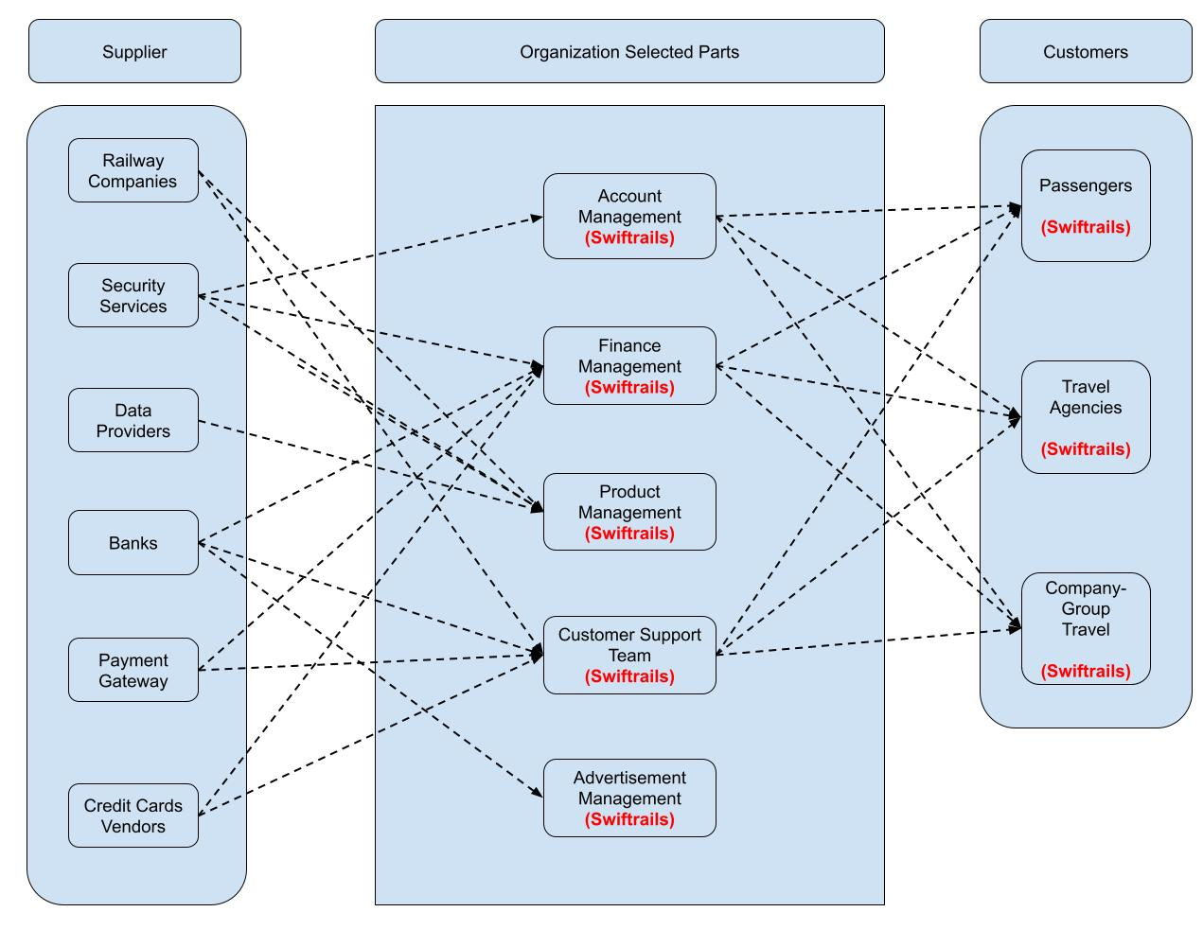
Swift Rail: Business Relation Map

Slide 2
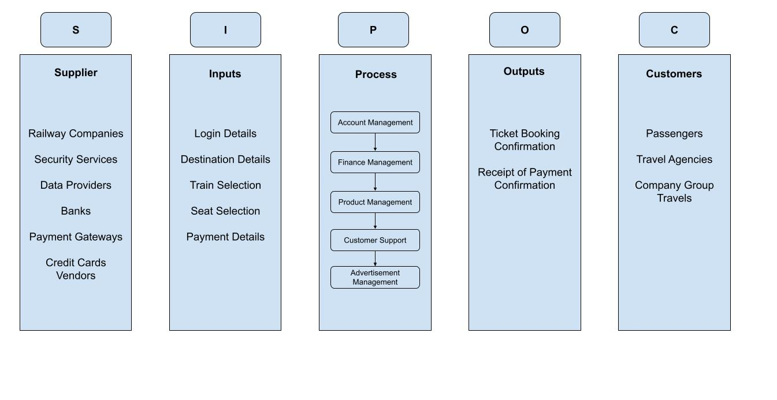
Swift Rail: SIPOC Diagram

Slide 3
User Roles by Business Group
External Users (Passengers)
Individual passengers
Travel groups
Corporate companies
Internal Users
Business Group | User Role | Team Members (Bus. Group Proxy)
Account Management | Client Manager | Dipesh
Finance Management | Accountant | Vrushali
Product Management | Product Manager | Dheeraj
Customer support | Customer Support Specialist | Harsha
Advertisement Management | Advertising Manager | Shashank

